Slide 1

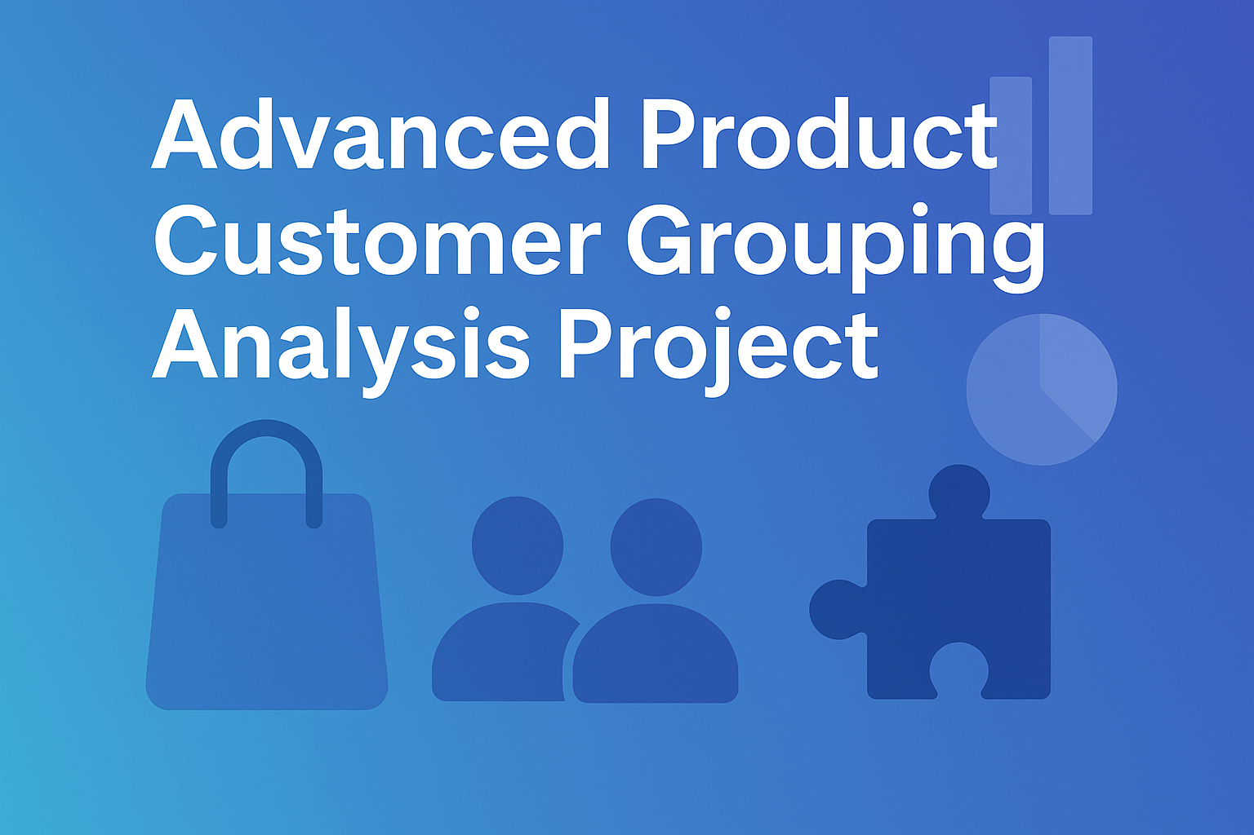
Power Query Project

Slide 2
Project Overview
Real-world customer-product analysis using Microsoft Power Query
Worked on transactional dataset with key fields:
-Product Name, Customer Name, Quantity, Price, Purchase Date, City, Payment Mode
Focused on handling repeated customer names and summarizing purchase behavior

Slide 3
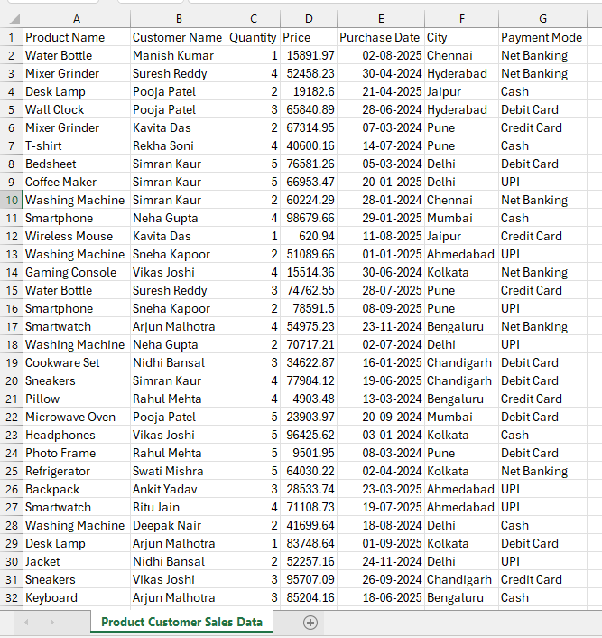
Project Overview

Slide 4
Project Challenge & Goal
Count how many times each product was purchased
Build a clean summary table for analytics
Ensure each unique product appears once
Combine all customer names who bought that product into one cell

Slide 5
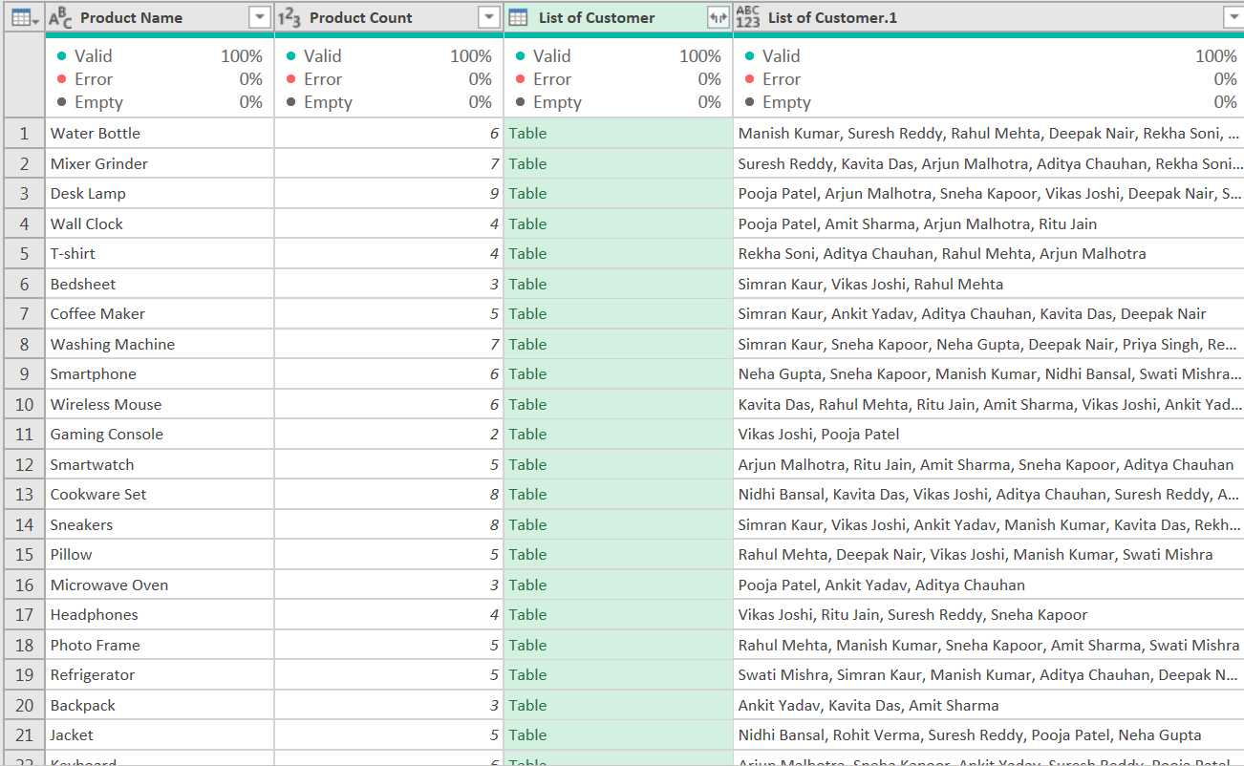
Project Goal

Slide 6


Learning Scope
What This Project Demonstrates
Real-world data aggregation and transformation
Hands-on use of Advanced Group By in Power Query
Customer segmentation and product insight generation
End-to-end ETL workflow (Extract → Transform → Load)

Slide 7




Dataset Preparation
Dataset generated via ChatGPT in CSV format
Simulated real-world purchasing patterns
Contained: Product, Customer, Quantity, Price, Purchase Date, City, Payment Mode
Included duplicate customer entries

Slide 8
Importing Data into Power Query
Opened CSV in Excel using Get Data → From Text/CSV
Loaded into Power Query Editor
S
W
Verified column types and headers
O
T
Ensured dataset consistency before transformation

Slide 9
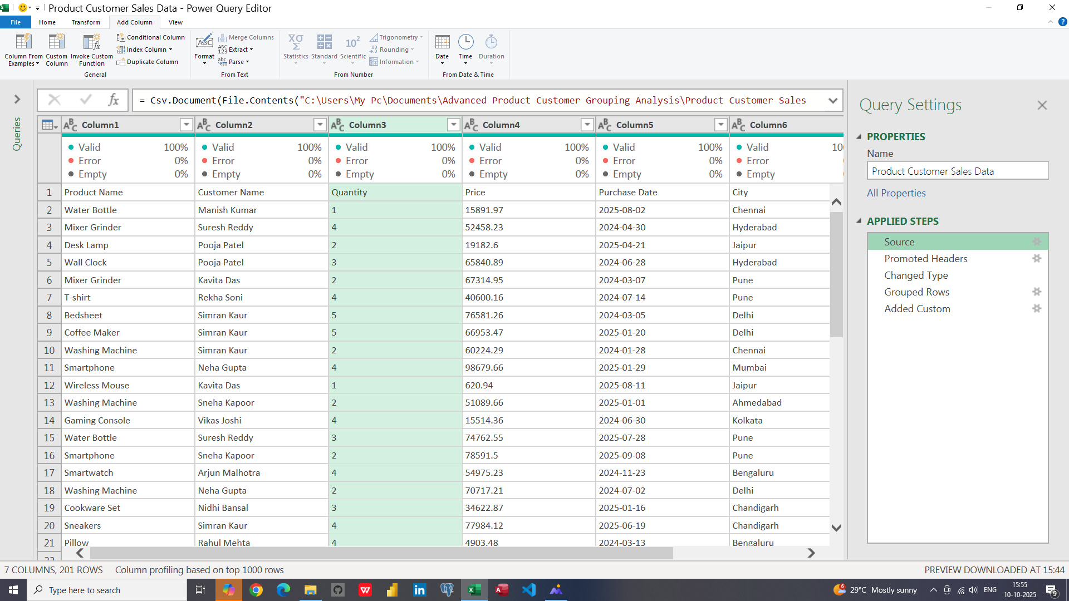
Importing Data into Power Query

Slide 10
Grouping and Aggregation
Used Advanced Group By in Power Query
Grouped by Product Name
Created 2 new aggregations:
Product Count → Count Rows
List of Customers → All Rows

Slide 11
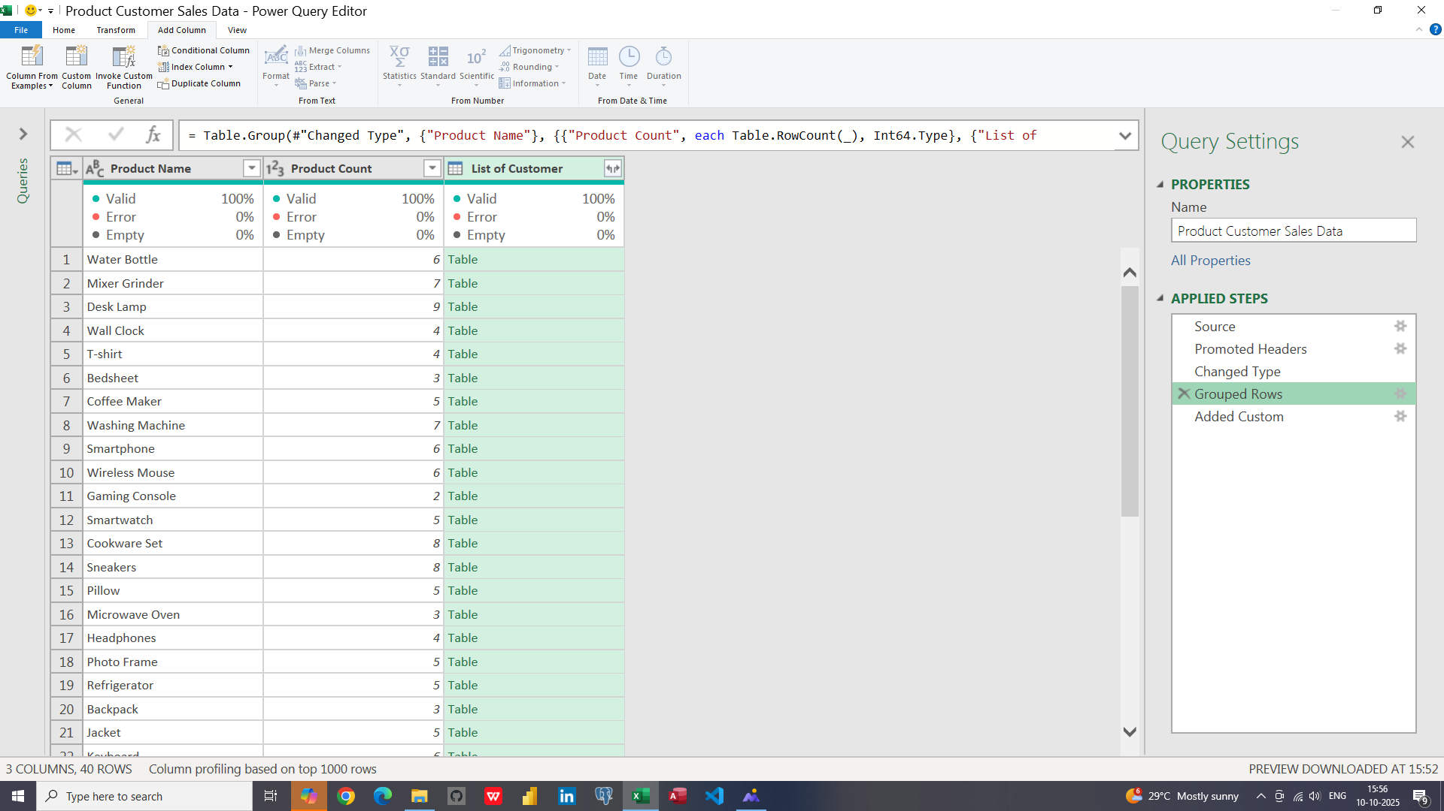
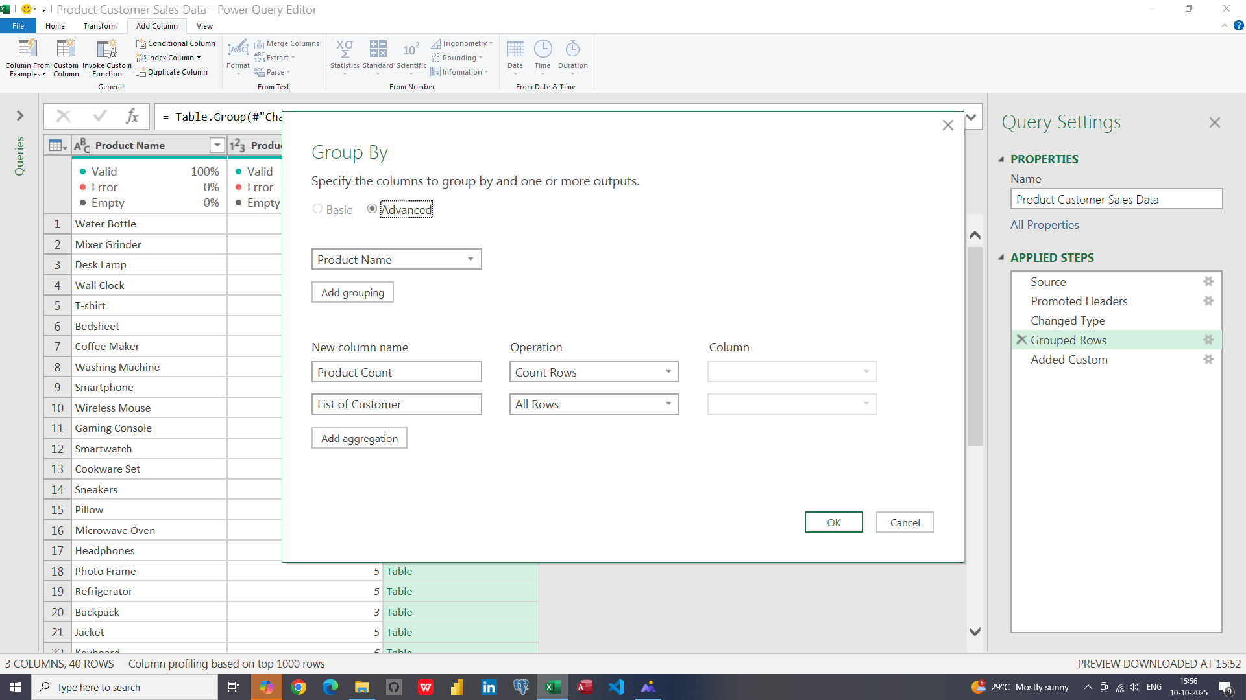
Grouping and Aggregation

Slide 12


Creating Custom Column
Used formula to combine all customers into one cell:
custom column
= Text.Combine([List of Customers][Customer Name], ", ")
-Converts nested list into a single text value
-Enhances readability and summary clarity

Slide 13
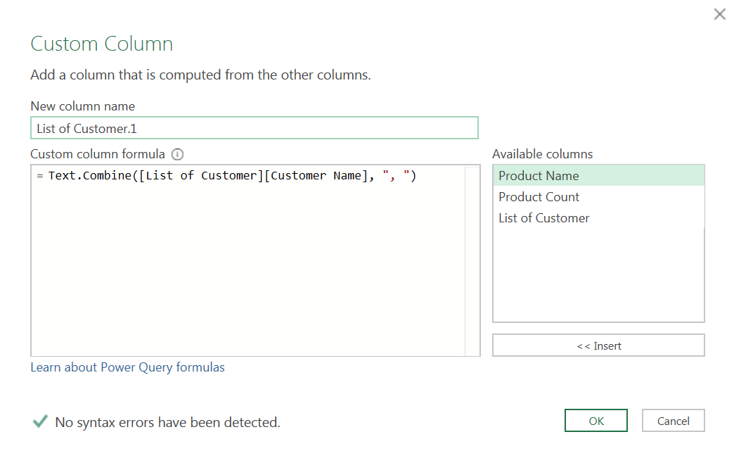
Creating Custom Column

Slide 14
Loading Clean Data
Excel
Used Close & Load To → Excel Sheet
Exported summarized data into Excel
Final dataset ready for dashboards and reporting
excel

Slide 15
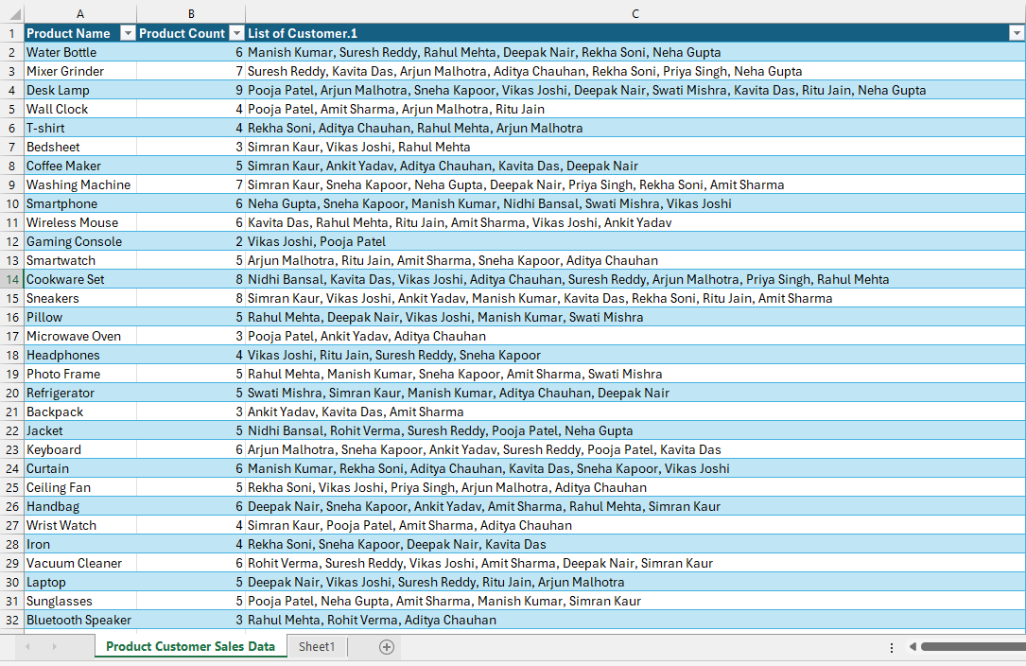
Loading Clean Data
Step Apply in Power Query

Slide 16
Key Skills Demonstrated
Data Aggregation & Grouping
Power Query ETL Process
Custom Column Logic with Text.Combine
Analytical Thinking & Problem Solving
Advanced Group By Implementation
Excel Integration for Reporting

Slide 17

Tools Used
Microsoft Power Query → Data Transformation
Microsoft Excel → Result Presentation
ChatGPT → Dataset Generation

Slide 18
Project Outcome
Clean summary of unique products
Automated purchase frequency calculation
Combined customer names in one field
Insightful data ready for BI dashboards
Improved understanding of real corporate data cleaning

Slide 19
Future Enhancements
Automate refresh for live data updates
Include trend and segmentation visuals
Add filters for date, city, and payment mode
Integrate Power BI dashboards

Slide 20
Learning Outcomes from This Project
Built end-to-end ETL workflows (Extract → Transform → Load)
Managed repeated & messy data efficiently
Improved analytical & problem-solving mindset
Hands-on experience with Power Query transformations
Understood aggregation, grouping, and text combining logic
Strengthened Excel-based data analysis approach

Slide 21
Real-World Relevance
⏱️ Automation: Saved hours of manual work
🏬 Retail & Sales: Customer-product purchase tracking
💳 E-Commerce: Combining customer orders across platforms
🏥 Healthcare: Patient-test mapping & frequency analysis
🏢 Corporate BI: Data cleaning for Power BI dashboards
💼 Foundation for roles in Data Analytics, BI & Excel Automation

Slide 22






Thank You
Every great presentation is complete with a great audience
— and that’s you!

